Slide 1
Global Optimization using Meta-Heuristics

Slide 2
Group Members
Faiza Shanawar (Team Leader) 15140070
Usama Imran 15140098
Haider Ali 15140101
Mohsin Qamar Khan 15140104

Slide 3
Global Optimization Using Meta Heuristics
Global optimization
Types of Global Optimization
Applications of global Optimization
Meta Heuristics
No Free lunch theorem
Related concepts and methodologies
Literature review
Other Algorithms
Proposed Methodology
Weka Inspiration
Feature Tree
References

Slide 4
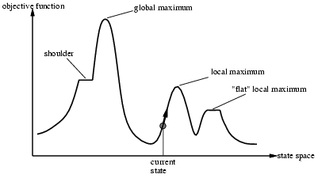
Optimization
Mathematical optimization or mathematical programming is the selection of a best element (with regard to some criterion) from some set of available alternatives.
Optimization is the process of finding the point that minimize or maximize a function.

Slide 5
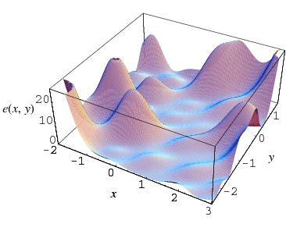
Global Optimization
The objective of global optimization is to find the globally best solution of models, in the (possible or known) presence of multiple local optima. Formally, global optimization seeks global solutions of a constrained optimization model.
global Maxima

Slide 6
Types of Global Optimization
Discrete Optimization
Continues Optimization
Single Objective Optimization
Multi-Objective Optimization
Combinatorial Optimization
Constrained Optimization
Unconstrained Optimization

Slide 7
What are Heuristics?
A heuristic is designed to provide better computational performance as compared to conventional optimization techniques, at the expense of lower accuracy.
Heuristic (from Greek εὑρίσκω "I find, discover") is a technique designed for solving a
problem more quickly, or for finding an approximate solution when classic methods.

Slide 8
What are Meta-Heuristics?
Metaheuristic is a higher-level procedure or heuristic designed to get a sufficiently good
solution to an optimization problem, especially with incomplete or imperfect
information or limited computation capacity.
Examples :
Genetic Algorithm
Simulating Annealing
Particle Swarm Optimization

Slide 9
Difference Between Heuristics and Metaheuristics.
Heuristics are problem depend and the performance varies whereas meta heuristics are
problem independent.
The most important difference between a heuristic and a meta-heuristic is that heuristics get stuck in local optima, while meta-heuristics have mechanism to avoid that.
As examples of this mechanisms, among others, we have:
Mutation (in Genetic Algorithm);

Slide 10
Real World Inspired Algorithms
Human social Behavior
Teacher-learning Algorithm
Swarm Based
Grey Wolf Optimization
Evolutionary Algorithms
Genetic Algorithm

Slide 11
Related Concepts and Jargons
Term | Explanation
Exploration
Exploitation
Convergence
Population Set
Fitness of a solution
Fitness Function

Slide 12
Literature Review

Slide 13
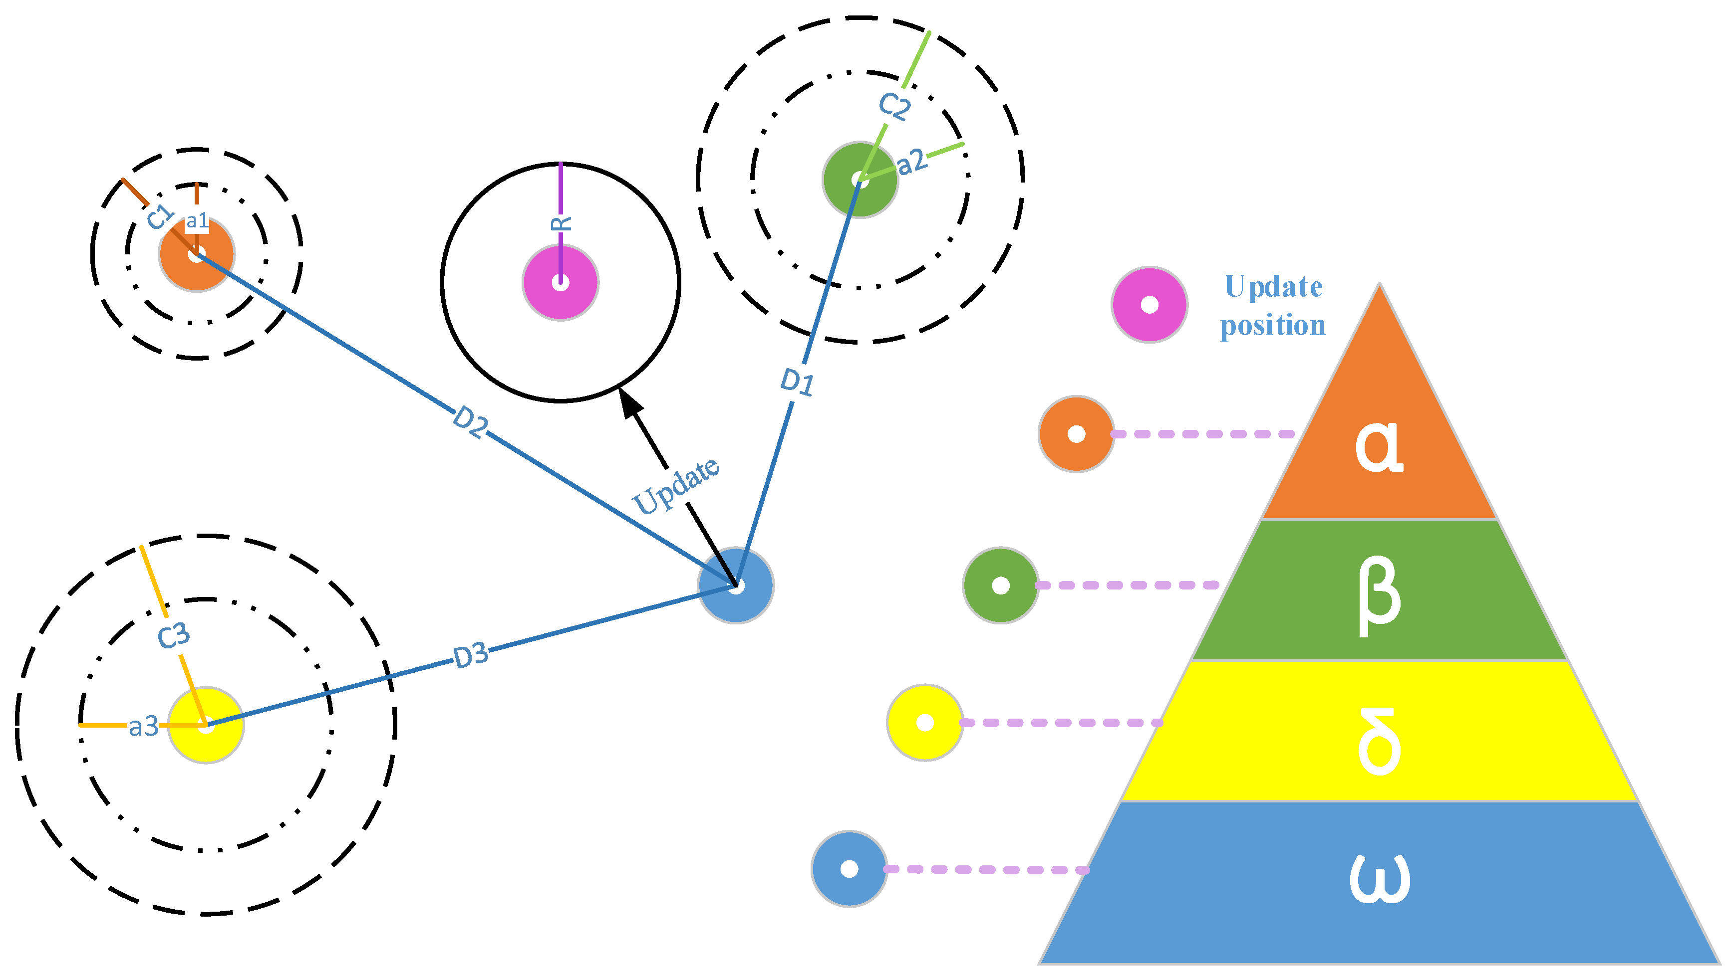
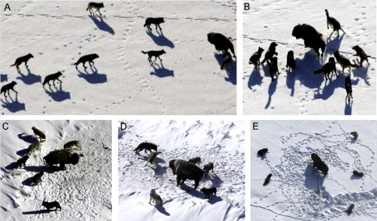
Grey Wolf Optimization
The GWO algorithm mimics the leadership hierarchy and hunting mechanism of Gray Wolf in nature proposed by Mirjalili et al. in 2014.Four types of grey wolves such as alpha, beta, delta, and omega are employed for simulating the leadership hierarchy. In addition, three main steps of hunting, searching for prey, encircling prey, and attacking prey, are implemented to perform optimization.

Slide 14
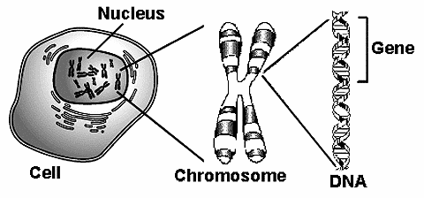
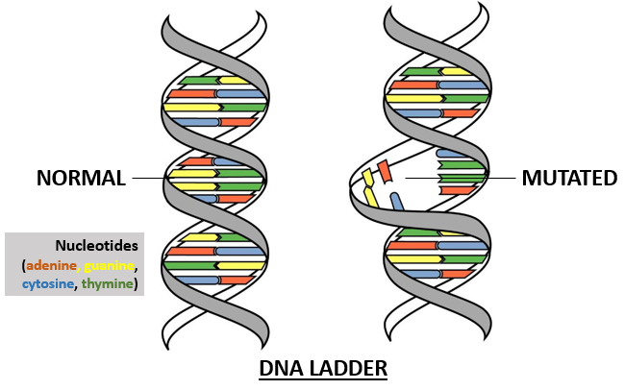
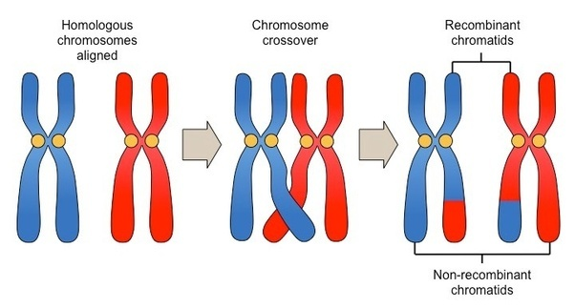
Genetic Algorithm
A genetic algorithm (GA) is a metaheuristics inspired by the process of natural selections that belongs to the larger class of evolutionary algorithms(EA). Genetic algorithms are commonly used to generate high-quality solutions to optimization and search problem by relying on bio-inspired operators such as mutation, crossover and selection.
Mutation
Chromosome crossover

Slide 15

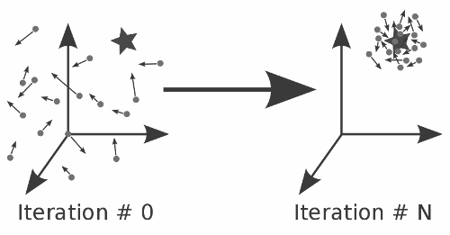
Particle Swarm Optimization
particle swarm optimization (PSO) is a computational method that optimizes a problem by iteratively trying to improve a candidate solution with regard to a given measure of quality.

Slide 16
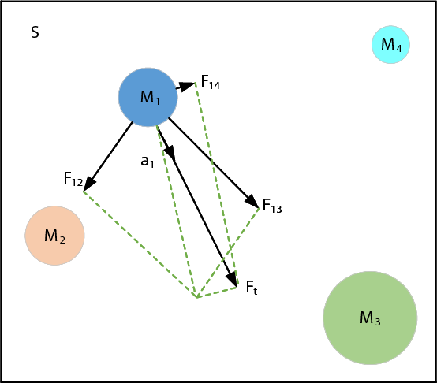
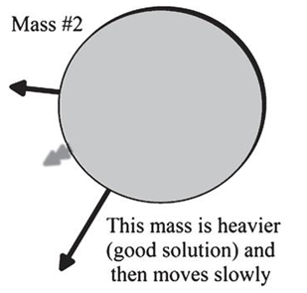
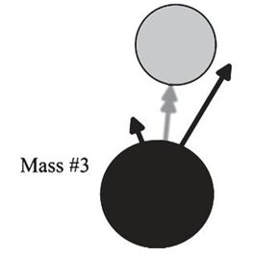
Gravitational Search Algorithm
Gravitational Search Algorithm is Physics based algorithm which is, as the name suggests, inspired from Newton’s law of Gravitation.

Slide 17
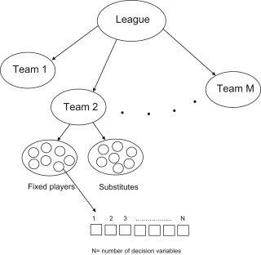
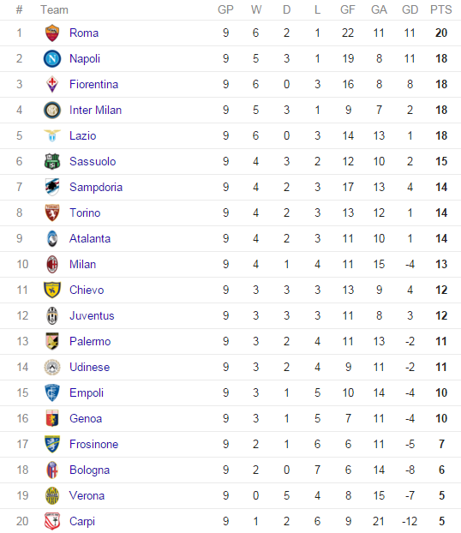
Soccer League Competition Algorithm
Soccer League Competition Algorithm is also an optimization algorithm inspired by the optimization of football league competitions.

Slide 18

Social Evolution Algorithm
Social Evolution Algorithm is inspired by human’s interactions and beliefs. The individuals interact and share information to its neighbor.
initialization phase
evaluation phase
interaction phase.

Slide 19

Teaching Learning Algorithm
Every individual learns from other individuals to improve themselves.
Inspired from class room teaching process.
This Algorithm simulates Three fundamental modes of learning
Through the Teacher (Teacher Phase)
Interacting with Other Learners(learner Phase)
Through Self Learning ( Self-Learning Phase)

Slide 20

Focus Group Algorithm
Inspired by the group who perform brainstorming and provides ideas on solving a particular problem
Focus Group members (provide ideas).
Facilitator (provides opportunity to everyone to represent ideas)
Note-taker (records all the ideas discussed)

Slide 21
Other Algorithms
Ant colony optimization algorithm
Drone squadron algorithm
Kill herd Algorithm
Whale optimization Algorithm
Whirlpool optimization Algorithm
Artifical bee colony optimization algorithm

Slide 22
Benchmark Functions
Optimization test functions, known as artificial landscapes, are useful to evaluate characteristics of optimization algorithms, such as:
Convergence rate
Precision
Robustness
General performance
 | BENCHMARK FUNCTIONS
Adjiman Function | Branin | Booth Function
Brad Function | Cross-in-Tray Function | Ackley
Cube Function | deVilliers Glasser 1

Slide 23
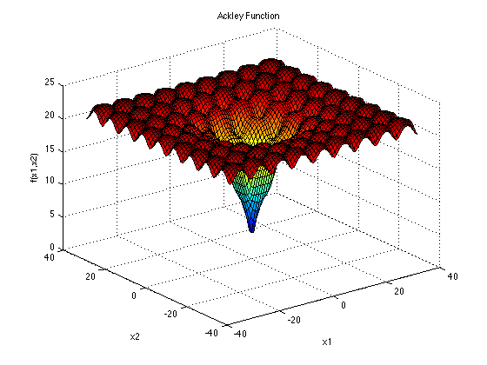
Benchmark Functions
Optimization Test Functions
The Ackley function is widely used for testing optimization
algorithms. In its two-dimensional form, as shown in the plot
above, it is characterized by a nearly flat outer region,
and a large hole at the centre.
The function poses a risk for optimization algorithms,
particularly hillclimbing algorithms, to be trapped in
one of its many local minima.

Slide 24
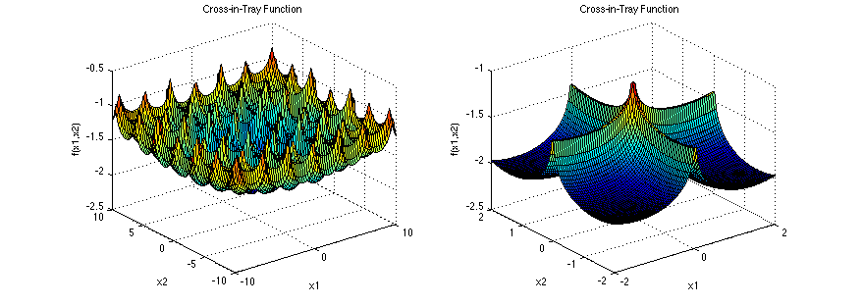
Benchmark Functions
Optimization Test Functions
The Cross-in-Tray function has multiple global minima. It is shown here with a smaller domain in the second plot, so that its characteristic "cross" will be visible.

Slide 25
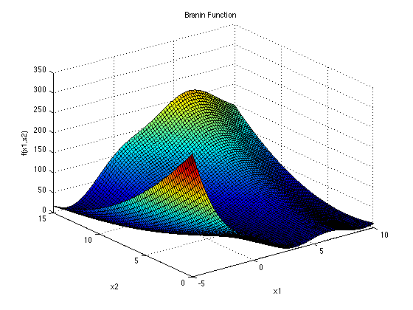
Benchmark Functions
Optimization Test Functions
The Branin, or Branin-Hoo, function has three
global minima.

Slide 26
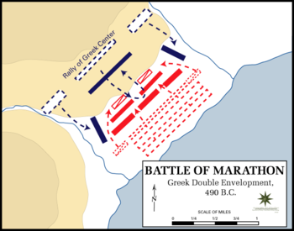
Our Inspiration: War Tactics
We are willing to develop an optimization algorithm. Inspiration we are using is War Tactics. There is no optimization algorithm that is inspired by war tactics according to our knowledge.

Slide 27
To Formulate Our idea
To Formulate our idea and we studies different books and paper on the strategy of war.
Books List:
Principles of War translation from the Japanese-by Dr. Joseph West
Army Doctrine publication of US military on offence and defensive In war strategies
Publish paper of the offence strategy of Altof Hilter used in WW2 against the France.
Paper on the Julius Caesar Offense tactics used against the Persians.
(All paper references are will be given at the end)

Slide 28
Proposed Application
In order to compare our algorithm with other algorithms, we are willing to develop
an application that would be able to compare these algorithms.
User can choose a particular algorithm and set its parameters and similarly, user can
choose second algorithm as well and then their comparison will be shown in the form of graph.
We would also test our algorithm on benchmark functions.

Slide 29

Our Application Inspiration: Weka

Slide 30
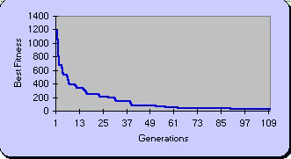
Application name: heikaku 1.0
Heikaku a Japanese word-(comparison)

Slide 31
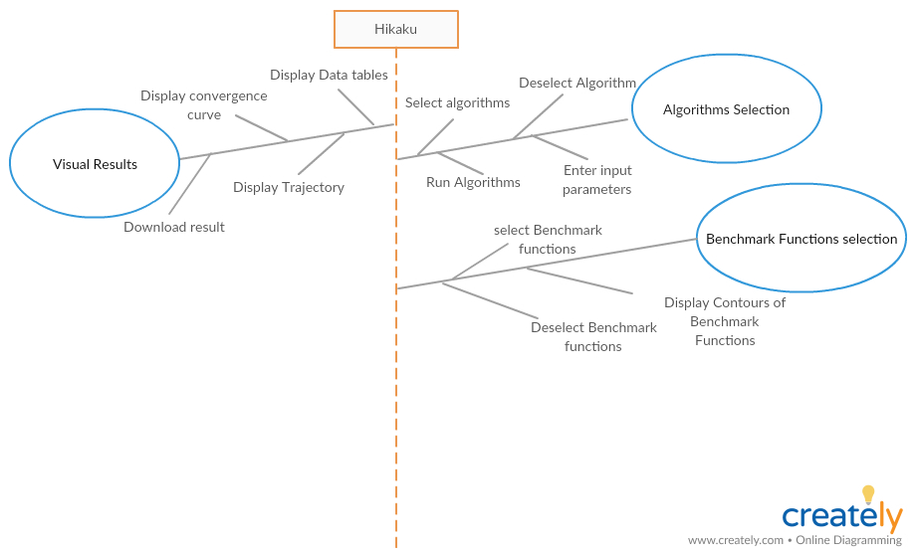
Feature tree of our Heikaku

Slide 32
References

